Slide 1
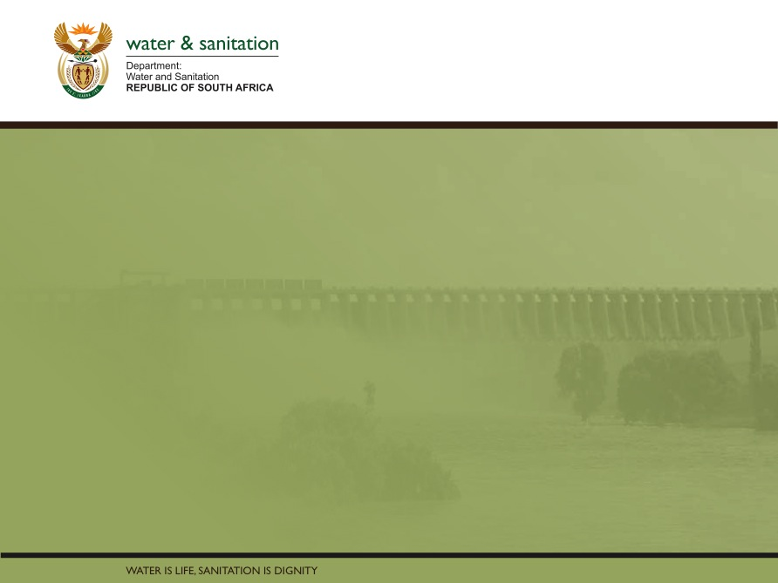
Classification, Reserve & RQO determination of water resources in the Mvoti to Umzimkulu Water Management Area
ESTUARY RQOs
Lara van Niekerk
CSIR
16 Sept 2015
PRESENTATION TITLE
Presented by:
Name Surname
Directorate
Date

Slide 2
RESOURCE QUALITY OBJECTIVES
1: Delineate units of analysis and describe the status quo (HOTSPOTS)
2: Initiation of stakeholder process and catchment visioning
3: Quantify EWRs and changes in Ecosystem Services
7: Gazette class configuration
4: Identification and evaluation of scenarios within IWRM
5: Draft Management Classes
6: Resource Quality Objectives (EcoSpecs & water quality (user))
RQOs : Where does it fit in?

Slide 3
  WHAT ARE RQOs?
RQOs capture the Management Class of the Classification System and the ecological needs determined in the Reserve into measurable management goals that give direction to resource managers as to how the resource needs to be managed.
RQOs for a water resource are a numerical or descriptive statement of the conditions which should be met in the receiving water resource, in terms of resource quality, in order to ensure that the water resource is protected.”

Slide 4
  RQOs and WATER RESOURCE CLASSES
  RQO LINKS TO CLASSIFICATION AND SCENARIOS
Water Resource Class
Operational Scenario/s
Informs
Defines
RQOs

Slide 5
For which components/indicators are RQOs set?
According to the Act:
Quantity, pattern & timing of instream flow (hydrology) (time series, FDC). Defined by the MC and catchment configuration (estuary EC)
Water quality (limits of driving variables)
Characteristics and condition of riparian and instream habitat and biota (change of area in habitat type, diversity and abundance of fish eg)
NOTE: Not all RQOs need to be set for all RUs – depends on priority and indicators selected.

Slide 6
Estuary RQOs
Hydrology, water quality, riparian and biota translate into the following components for estuaries for which RQOs must be set.
  Flow
  Mouth State
  Sediment processes
  Salinity
  Other Water Quality
  Microalgae (priority systems)
  Macrophytes
  Invertebrates
  Fish
  Birds (priority systems)
  Contact recreation
More detailed RQOs called Ecospecs for Mvoti & uMkomazi

Slide 7
FOR WHICH ESTUARIES WILL ONE SET RQOs?
Will deal with all estuaries – but at different level of detail.
Detail depend data availability and priority.

Slide 8
RQO Approach for Estuaries:
Evaluate existing regional datasets
Extrapolate from similar systems
Water Quality: Ecosystems limits and national guidelines
Indicate were additional data needs to be collected
Develop for all the systems, not just priorities

Slide 9
uMkomazi RQO = TEC B/C
Component | EC | Narrative RQO*
Hydrology | C/D | Maintain a flow regime to create the required habitat for birds, fish, macrophytes, microalgae and water quality
Hydrodynamics | A | Maintain mouth conditions to create the required habitat: Mouth closure occurs more than 2 - 3 weeks in a year Mouth closure occurs for more than 2 years out of ten Mouth closure occurs between Sep and Apr
Water Quality | C | Salinity distribution and system variables (pH, dissolved oxygen and turbidity) not to cause exceedence of TPCs for biota Inorganic nutrient concentrations (NO₃-N, NH₃-N and PO₄-P) not to cause in exceedance of TPCs for macrophytes and microalgae Presence of toxic substances not to cause exceedence of TPCs for biota
Sediment dynamics | B | Flood regime to maintain the sediment distribution patterns and aquatic habitat (instream physical habitat) Changes in sediment grain size distribution patterns not to cause exceedance of TPCs in benthic invertebrates.
*The NARRATIVE RQOs provided here include some numerical information. All narrative RQOs supported by numerical RQOs in the technical documents

Slide 10
uMkomazi RQO = TEC B/C
Component | EC | Narrative RQO
Microalgae | B | Maintain current microalgae assemblages, specifically >5 diatom species at a frequency >3% of the total population in saline reaches in low flow
Macrophytes | D | Maintain the distribution of macrophyte habitats, integrity of the riparian are (Zone C no sandmining). No invasive floating aquatic species present e.g. water hyacinth. No sugarcane in the estuarine functional zone.
Invertebrates | B | Maintain current zoobenthic abundance (seasonal variation) & Species diversity (15 species in summer / 40 species in winter). Retain an invertebrate community assemblage that includes a variety of indigenous species. Polychaetes, amphipods and tanaeids should numerically dominate.
Fish | D | Zone C (below weir) acts as a nursery to diversity of estuarine associated & dependant species. A good trophic basis exists for predatory estuarine dependant marine species. Estuarine residents species is core group . Oreochromis mossambicus limited to the upper reaches (Zone C) in the low flow period. Species assemblage comprises indigenous species only. Connectivity with transitional marine-estuary waters is maintained
Birds | C | The most characteristic component of the avifaunal waterbird community is the piscivores: Resident pair of African Fish Eagle present and breeding. Pied Kingfishers, White-breasted Cormorants or Reed Cormorants present. Numbers of waterbird species not below 10.

Slide 11
Mvoti RQO = TEC C/D
Component | EC | Narrative RQO
Hydrology | C/D | Maintain a flow regime to create the required habitat for birds, fish, macrophytes, microalgae and water quality Monthly river inflow < 1.0 m³/s Monthly river inflow < 2.0 m³/s for longer than 3 months in a row Monthly river inflow < 2.0 m³/s for more than 50% of the time
Hydrodynamics | A | Maintain mouth conditions to create the required habitat: Mouth closure occurs more than 2 - 3 weeks in a year. Mouth closure occurs for more than 2 years out of ten Mouth closure occurs between Nov and Jun
Water Quality | C/D | Salinity distribution and system variables (pH, dissolved oxygen and turbidity) not to cause exceedence of TPCs for biota Inorganic nutrient concentrations (NO₃-N, NH₃-N and PO₄-P) not to cause in exceedance of TPCs for macrophytes and microalgae Presence of toxic substances not to cause exceedence of TPCs for biota
Sediment dynamics | B/C | Flood regime to maintain the sediment distribution patterns and aquatic habitat (instream physical habitat) Changes in sediment grain size distribution patterns not to cause exceedance of TPCs in benthic invertebrates.

Slide 12
Mvoti RQO = TEC C/D
Component | EC | Narrative RQO
Microalgae | B | Maintain current microalgae assemblages, specifically >5 diatom species at a frequency >3% of the total population in saline reaches
Macrophytes | D | Maintain the distribution of macrophyte habitats, particularly the freshwater mangrove, Barringtonia racemosa stand at the mouth of the estuary. Control the spread of hygrophilous grasses into open water area. Prevent the spread of invasive plants, trees, shrubs & aquatic invasive plants. No sugarcane in the estuarine functional zone.
Invertebrates | E | N/A
Fish | D | Nursery for estuarine dependant marine fishes in juvenile and adult life stages. Act as habitat for estuarine resident fishes and freshwater fishes Migration corridor for facultative catadromous eels.
Birds | E | Avifaunal waterbird community should increase slightly in diversity and abundance from present - with representatives of all the major groups: aerial (e.g. kingfishers), swimming (e.g. cormorants), large wading piscivores (e.g. herons), small invertebrate-feeding waders (+ migratory Palaearctic sandpipers), herbivorous waterfowl (e.g. ducks and geese) and roosting terns and gulls

Slide 13
PRESENTATION TITLE
Presented by:
Name Surname
Directorate
Date
THANK yOU

